Slide 1
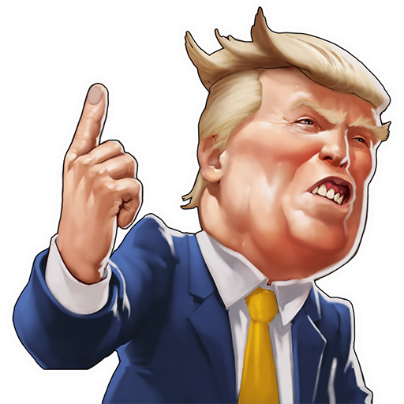
who picked trump:
america or russia?
Aifaz | Andrew | Avani | Jonathan

Slide 2


background
Internet Research Agency
Two Clemson professors assembled the data
Russian troll factory sent the tweets
Fivethirtyeight released the data
Notes:
400 employees
Clemson Professors

Slide 3

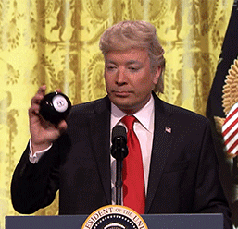

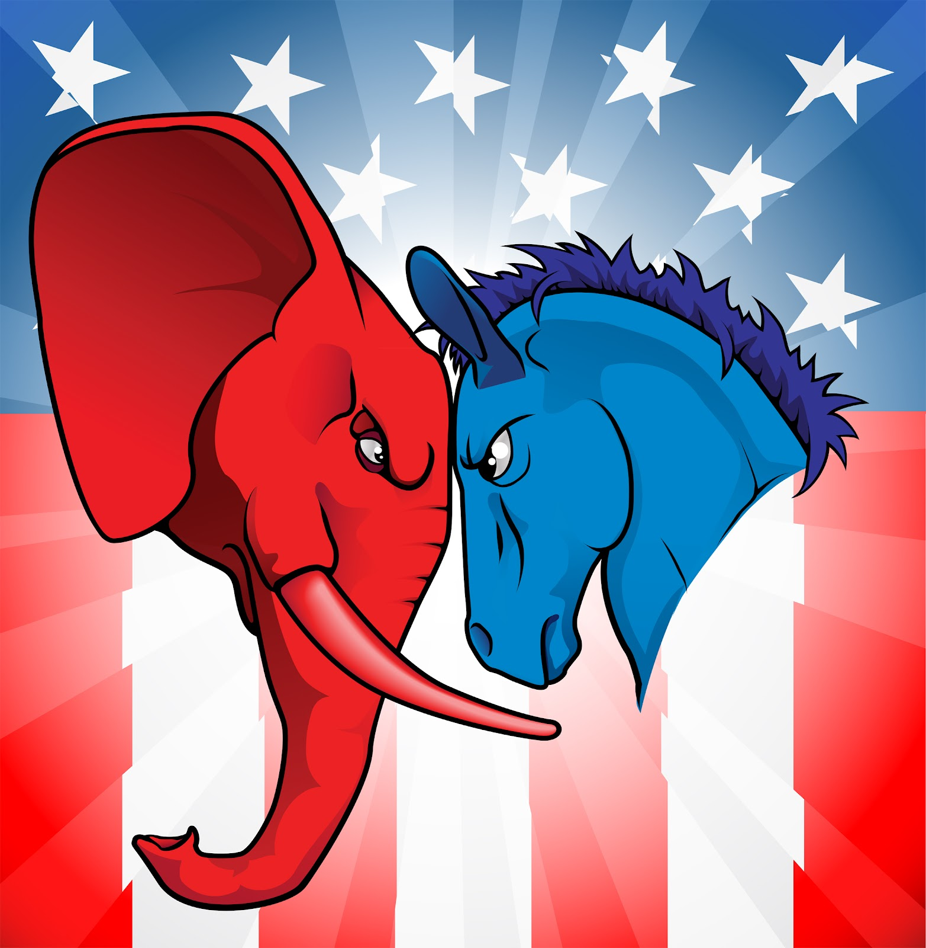
Importance of our analysis
Become better informed citizens
Understand when to expect troll tweets
See how truthful the fake news theories are
see impact on political views
Notes:
Presence of false information should be regulated by exploiting the data
Social media

Slide 4

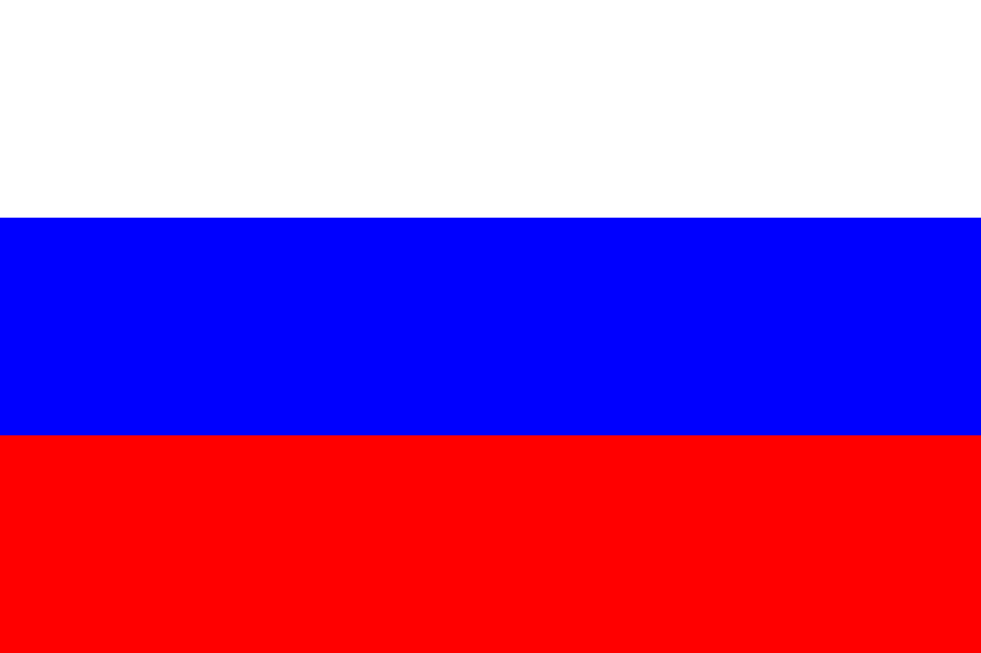
Data we used
Russian Troll tweets from 2012-2018
671 MB | 3 Million Rows | 15 columns
Notes:
https://www.kaggle.com/fivethirtyeight/russian-troll-tweets
Talk about columns!!!!!

Slide 5

Exploratory analysis

Slide 6
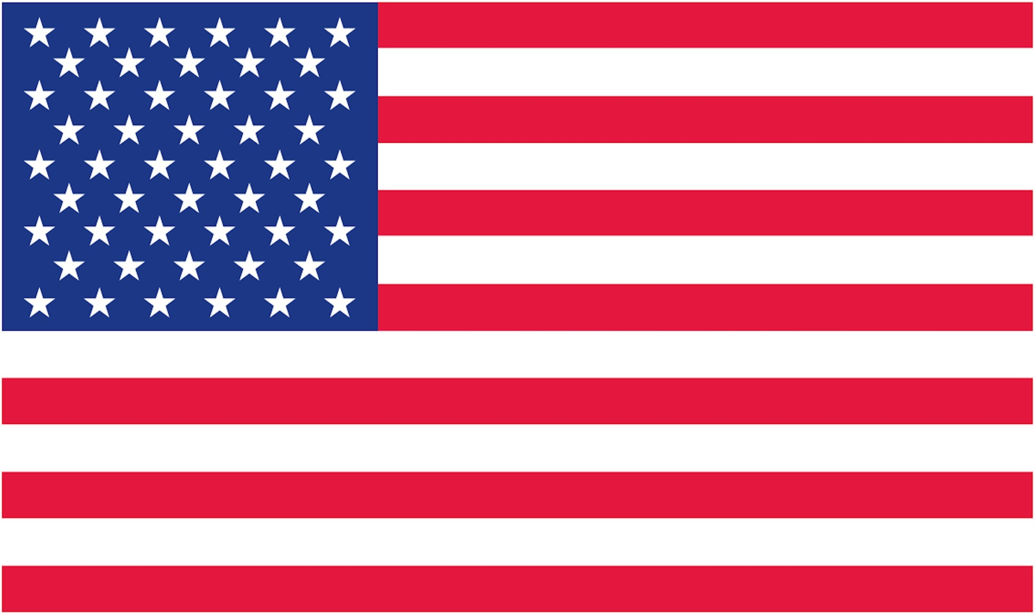
MOST Active Trolls
@exquote
@screamymonkey
@ameliebaldwin
@worldnewspoli
@todaypittsburgh
Total tweets
Total tweets
Total tweets
Total tweets
Total tweets
59,652
44,041
36,974
35,371
33,602
Region
Region
Region
Region
Region
Category
Category
Category
Category
Category
commercial
News feed
Right Troll
Right troll
News feed

Slide 7
MOST POPULAR Trolls
@novostimsk
@ten_gop
@novostispb
@kadirovrussia
@maxdementiev
followers
Followers
Followers
Followers
Followers
251,276
145,244
113,638
110,115
103,197
Region
Region
Region
Region
Region
UNKNOWN
UNKNOWN
Category
Category
Category
Category
Category
Right Troll
left Troll
Non-english
Right Troll
left Troll

Slide 8
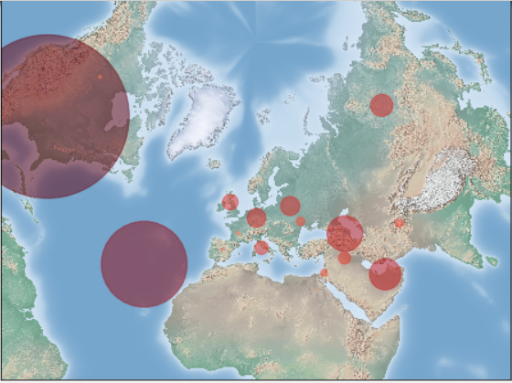
Most Active Regions
Russian federation
USA
> 37,000 tweets
> 2,000,000 Tweets
azerbaijan
> 100,000 tweets
Unknown
United arab emirates (UAE)
> 500,000 Tweets
> 74,000 tweets

Slide 9
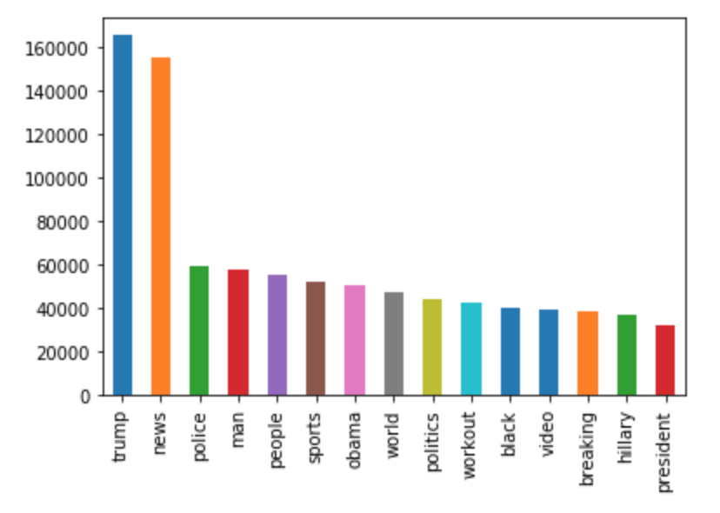
Most common Words
Insights
We probably shouldn’t show these findings to trump
he’s mentioned over 160,000 times
#1 - Trump (165,399)
Notes:
https://www.kaggle.com/fivethirtyeight/russian-troll-tweets

Slide 10
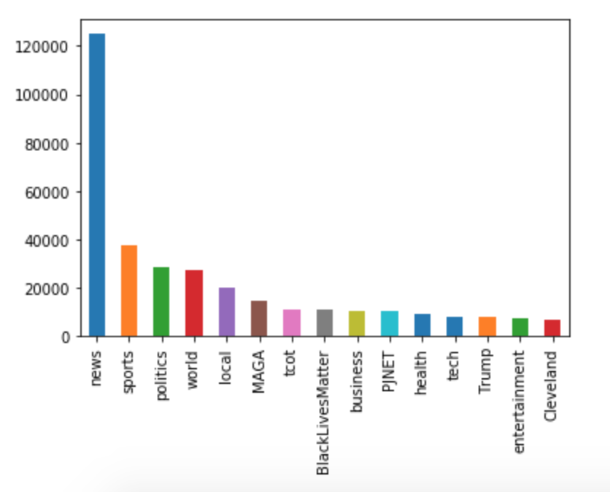

Most common Hashtags
insights
Trolls focused heavily on news
Cleveland made the list somehow
Sports are a common topic of discussion
#1 - News (124,946)
Notes:
https://www.kaggle.com/fivethirtyeight/russian-troll-tweets

Slide 11
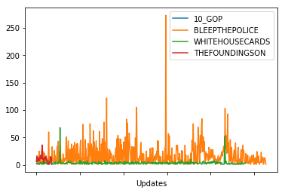
Tweet Sensitivity over time
Most activity on July 7, 2016
(Dallas police shooting)

Slide 12
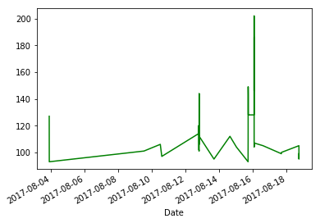
Most active time frame
Aug. 4, 2017
Aug. 13, 2017
Aug. 16, 2017
Rawandan president wins
Charlottesville March
Confed. statue removed

Slide 13
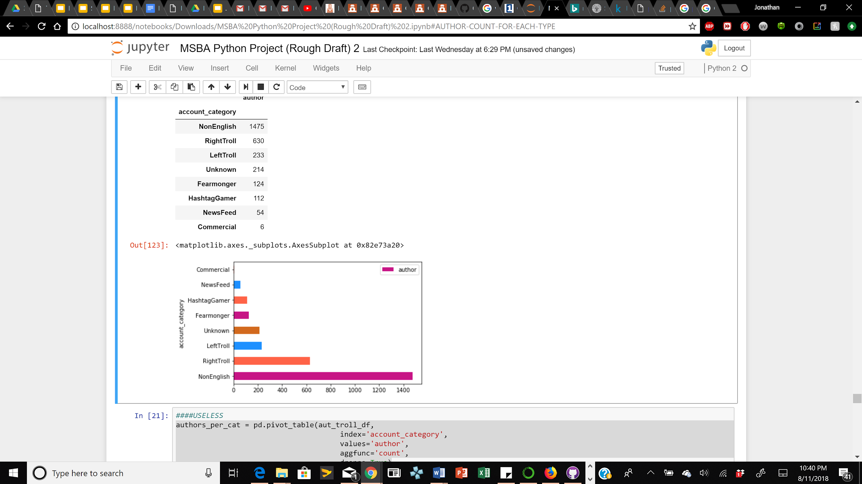
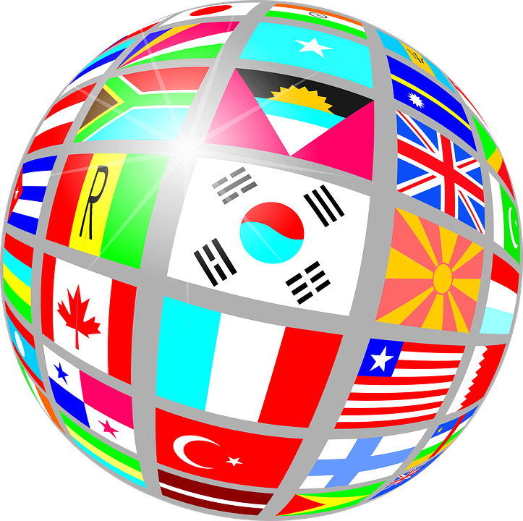
Authors per category
Most authors are non-english

Slide 14
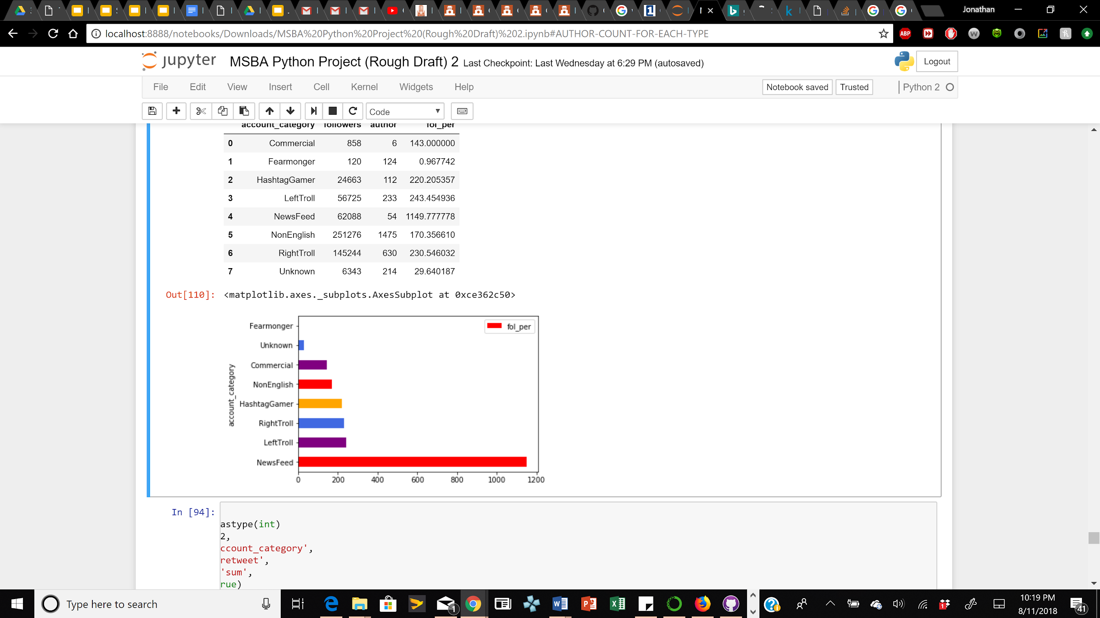

Average followers per author
News feeds have the most followers per author

Slide 15
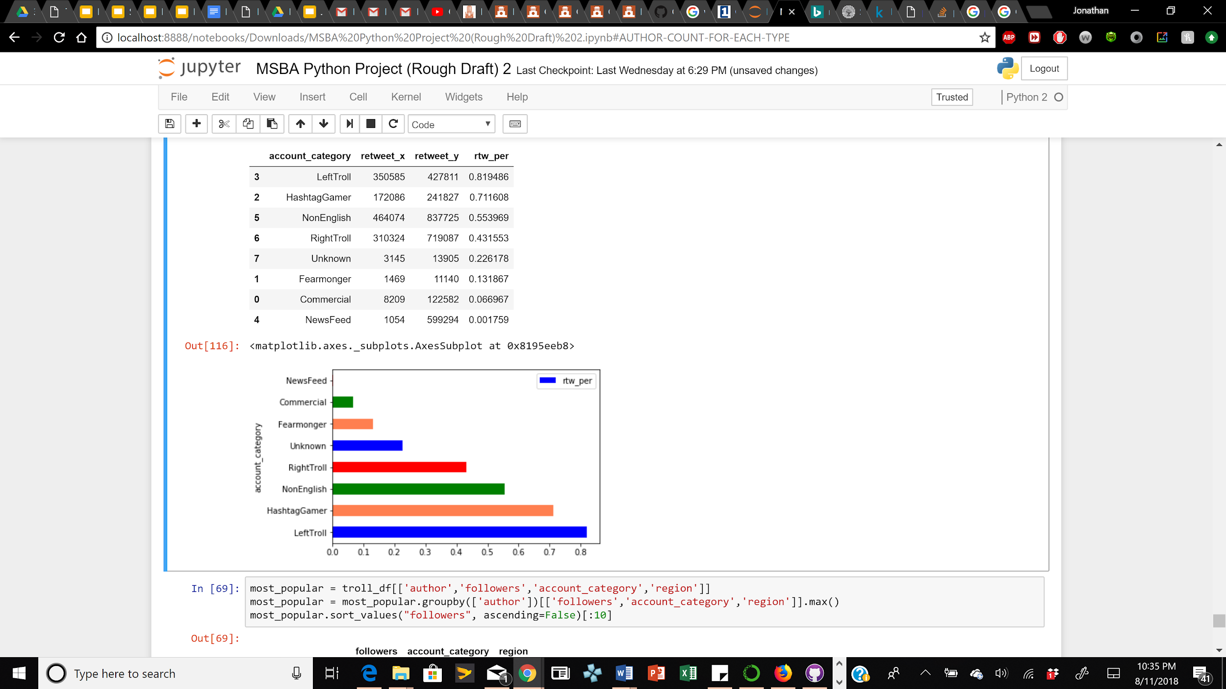

Retweet percentage per category
Left trolls retweet the most

Slide 16
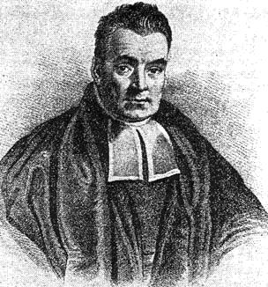
Naive bayes
In memory of our Hero, Thomas Bayes

Slide 17
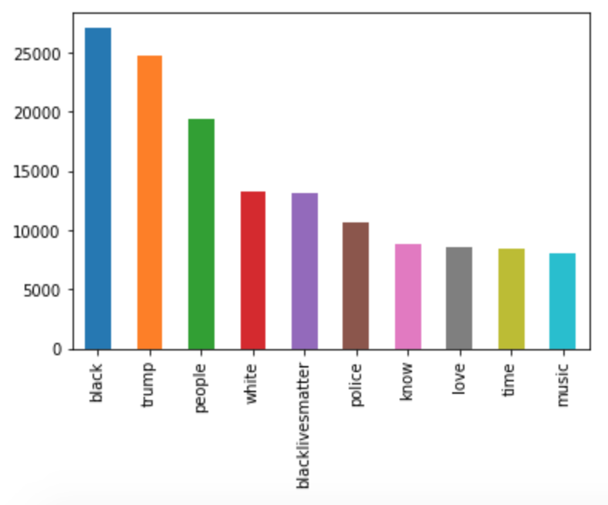

Most common words (left)
insights
“Black” is at the top
“We made it!”
-Jonathan Evans, 2018
#1 - black (27,041)
Notes:
https://www.kaggle.com/fivethirtyeight/russian-troll-tweets

Slide 18
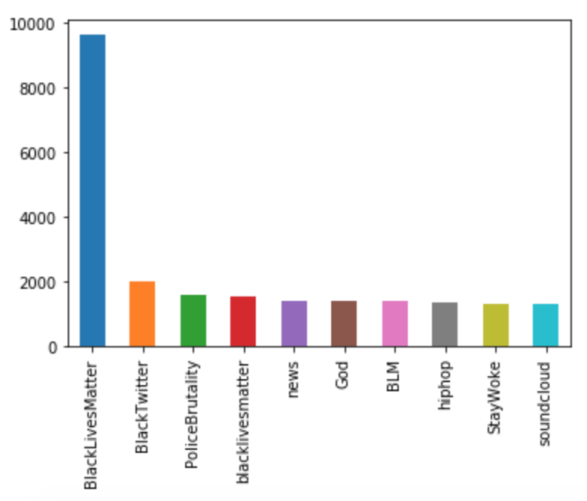

Most common hashtags (left)
Insights
Left trolls tried to appeal to black twitter users
SOUNDCLOUD - twitter trolls make mixtapes too
#1 - BLM (9,618)
Notes:
https://www.kaggle.com/fivethirtyeight/russian-troll-tweets

Slide 19
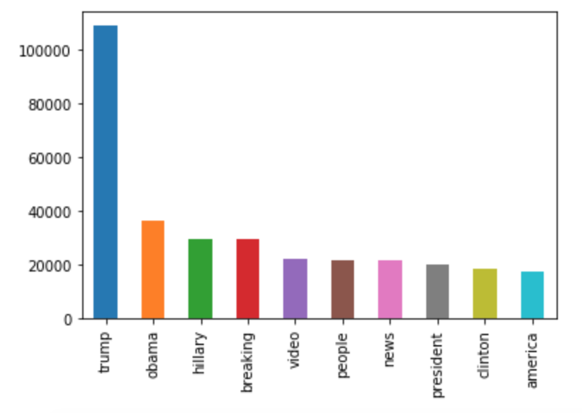

Most common Words (Right)
Insights
Right trolls tend to only discuss politics
#1 - Trump (108,891)
Notes:
https://www.kaggle.com/fivethirtyeight/russian-troll-tweets

Slide 20
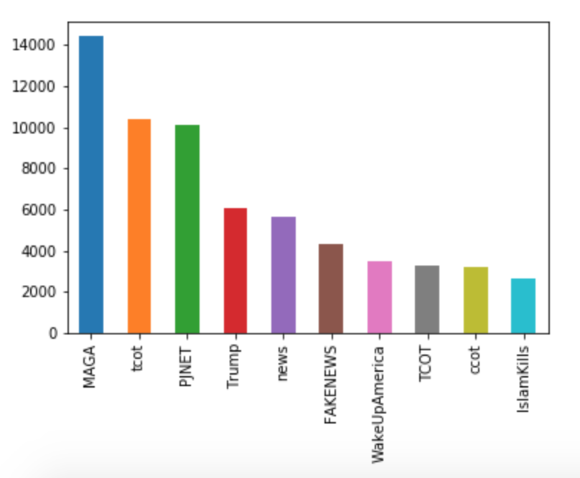

Most common Hashtags (Right)
insights
TCOT - top conservatives on twitter
PJNET - patriot journalist network
Wake up america - apparently, america is sleepy
#1 - MAGA (14,443)
Notes:
https://www.kaggle.com/fivethirtyeight/russian-troll-tweets

Slide 21
Results
Top Hashtags | 50 | 100 | 500
Words Used | 500 | 1,000 | 5,000
True Negative | 256,270 | 256,240 | 255,907
True Positive | 119 | 563 | 1,821
False Positive | 1 | 31 | 364
False Negative | 75,431 | 74,987 | 73,729
True Predictions | 77.26% | 77.39% | 77.67%
Notes:
To note, as the amount of words and hashtags used went up, the importance of words ranking went down and importance of hashtags ranking went up. Features used in Naive bayes: region in the US or not, english acct or not, was it a retweet, num top words included, top hashtags included. Close to 800,000 words and 40,000 hashtags. Issue model faces is that is looks at single tweets rather than authors

Slide 22
Final model
100
hashtags
/
1000
words
100 hashtag / 1000 word Naive Bayes model
77% accuracy

Slide 23

Solutions

Slide 24




Solutions
1
2
3
4
Don’t go to twitter for political information - try reading a newspaper
Deactivate all of your social media accounts and become amish
Fact check everything you read
Pay close attention to hashtags

Slide 25
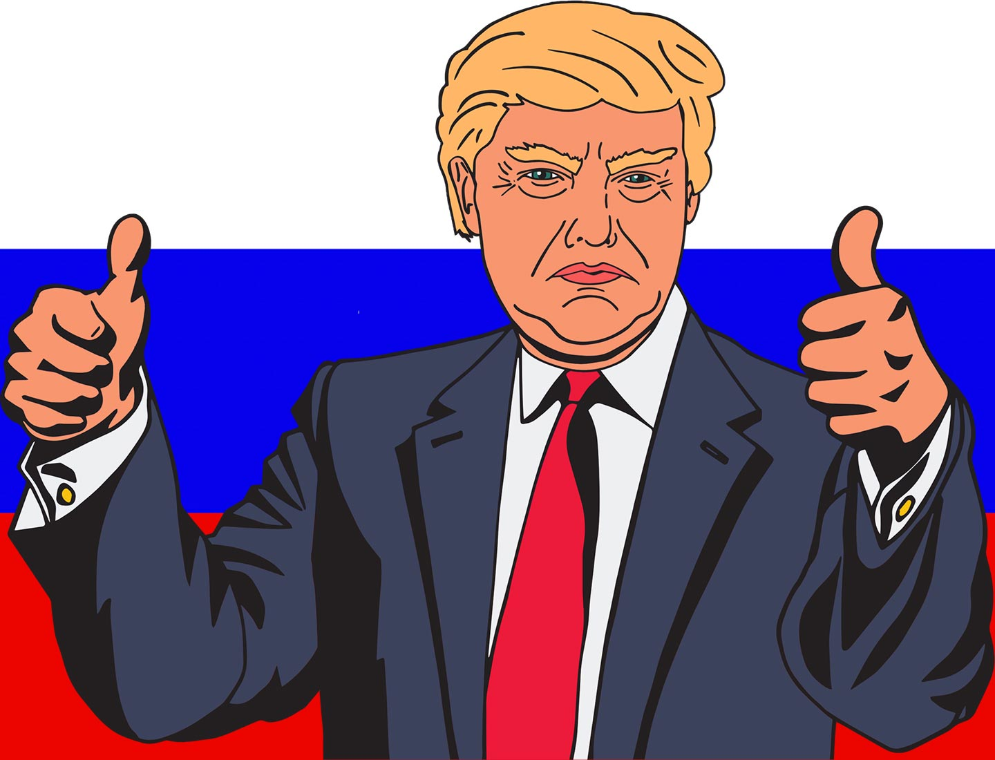
Questions?

